Slide 1


Siva Prasad C P
05/11/2021

Slide 2

Outline
Executive Summary
Introduction
Methodology
Results
Conclusion
Appendix

Slide 3
Executive Summary
Summary of methodologies
Data Collection using API
Data collection using web scraping
Data wrangling using EDA
EDA with SQL
EDA and data visualization
Visual analytics with Folium
Prediction using machine learning
Summary of all results
Data Visualization for understanding data
Trends study from data
Machine leaening prediction for SpaceY

Slide 4
Introduction
Project background and context
The project was to know the probability of Falcon9 lands successfully .If the initial launcher lands safely the cost of subsequent launches will be lower than the other spacecraft company. The information can be used to bid against spacex launcher.
Problems you want to find answers
Project aims to achieve low cost launches and measures success rate based on the payload mass, other details from SpaceX falcon9.
It aims to determine the cost of each launch depending on the specifics such as payloadmass,boosterversion etc.
Using Machine learning principles to verify initial can be reused.

Slide 5


Slide 6
Methodology
Executive Summary
Data collection methodology:
Web scrapping
API data collection
Perform data wrangling
One hot encoding for machine learning
Perform exploratory data analysis (EDA) using visualization and SQL
Plots like bar graph, pie chart and scatter plots to illustrte the data.

Slide 7
Data Collection
Describe how data sets were collected.
You need to present your data collection process use key phrases and flowcharts
Data collection by SpaceX API which gives information about launches,payload etc.
ML model developeed from this data was used to predict whether SpaceY’s initial launch would be a success.
Additional information from web scraping wikipedia about the first launch of Falcon9
Used BeautifulSoup for building upon web scraping.
SpaceX API
.json file
.json to .csv file
HTML link
BeautifulSoup to extract data
Normalization and transform into .csv files

Slide 8
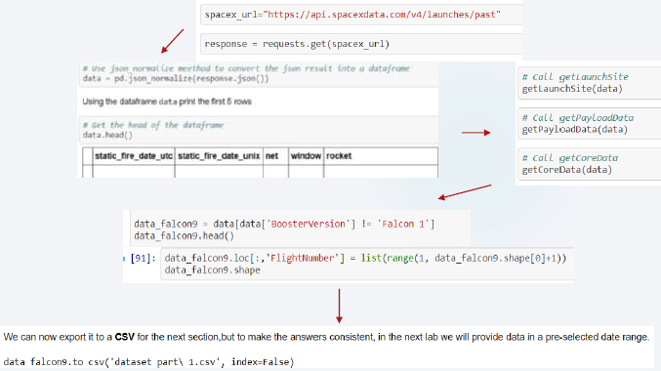
Data Collection – SpaceX API
Present your data collection with SpaceX REST calls using key phrases and flowcharts
https://github.com/sivap98/finals/blob/main/ghvhmv.ipynb
Place your flowchart of SpaceX API calls here

Slide 9
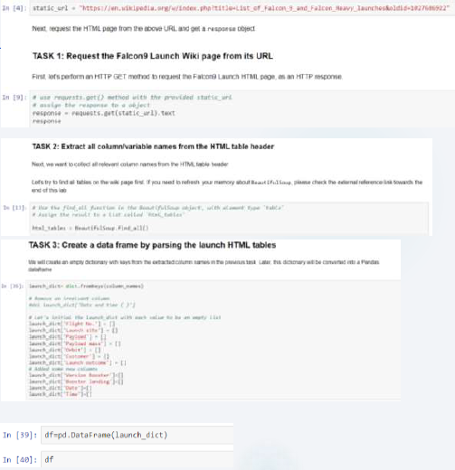
Data Collection - Scraping
Present your web scraping process using key phrases and flowcharts
https://github.com/sivap98/finals/blob/main/web%20scrapping.ipynb
Place your flowchart of web scraping here

Slide 10
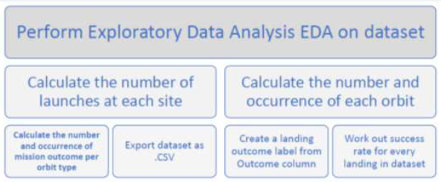
Data Wrangling
Describe how data were processed
You need to present your data wrangling process using key phrases and flowcharts
https://github.com/sivap98/finals/blob/main/Data%20wrangling.ipynb
Data Wrangling allows us to perform EDA to label for training supervised models.
We converted successful landing as 1 else 0

Slide 11
EDA with Data Visualization
Bar plot: Categorizes success rate Vs Orbit data.
Scatter plot: Establishes trends between numeric variables
Launch site Vs flight number
Payload mass Vs Flight number
Payload mass Vs launch site
Payload Mass vs Orbit
Line plots: Time plots
Success rate vs year
https://github.com/sivap98/finals/blob/main/Data%20visualisation.ipynb

Slide 12
Displayed the names of unique launch sites
Displayed 5 records of ‘CCA’ beginning launch sites
Displayed total payload mass by NASA boosters
Average payload mass carried by booster version F9 v1.1
List the date of first successful landing outcome.
Listed the names of boosters of success drone ship and payload mass>4000,<6000.
Total number of success and failure
Names of boosters of maximum payload mass
Failed landing outcomes in 2015 on drone ship, booter versions and launch site names.
Rank the count of landing outcomes
https://github.com/sivap98/finals/blob/main/eda%20ffom%20sql.ipynb
EDA with SQL

Slide 13
Build an Interactive Map with Folium
The launch success rate may depend on many factors such as payload mass, orbit type, and so on. It may also depend on the location and proximities of a launch site, i.e., the initial position of rocket trajectories. Finding an optimal location for building a launch site certainly involves many factors and hopefully we could discover some of the factors by analyzing the existing launch site locations.
To visualize the Launch Data, took the Latitude and Longitude Coordinates at each launch site and added a Circle Marker around each launch site with a label of the name of the launch site. Then assigned the dataframe launch_outcomes(failures, successes) to classes with 0 and 1 with Green and Red markers on the map in a MarkerCluster()
https://github.com/sivap98/finals/blob/main/folium.ipynb

Slide 14
Build a Dashboard with Plotly Dash
Used Flask and Dash framework
Pie charts: Proprtions of different affecting parameters
Scatter Graph: Outcome vs Payload mass for different booster versions
Best to show non linear relationships between two variables with straightforward observation and reading.

Slide 15
Predictive Analysis (Classification)
In predictive analysis SpaceX advertises Falcon9 rocket launches on its website with a cost of more than one third of the cost of other companies. This is because they can reuse first stage. Therefore, determining the probability of safe landing of first launch, determines cost of rocket launch. This explains ML algorithm and model.
Create class column
Standardize Data
Split data into train and test sets to meassure accuracy

Slide 16
Results
Exploratory data analysis results
Interactive analytics demo in screenshots
Predictive analysis results

Slide 17


Slide 18
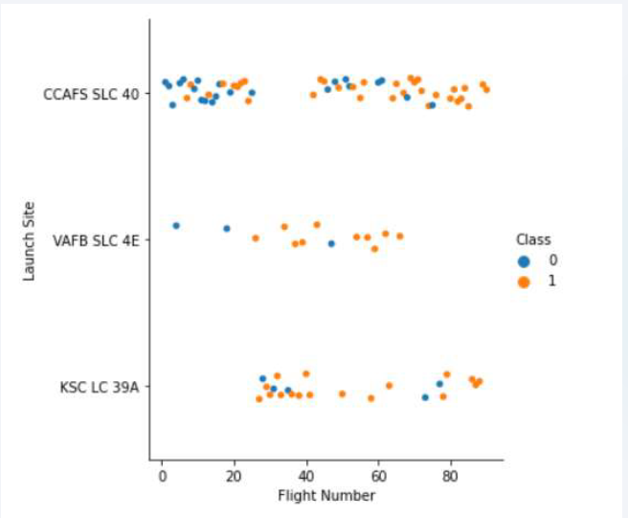
Flight Number vs. Launch Site
Show a scatter plot of Flight Number vs. Launch Site
Show the screenshot of the scatter plot with explanations

Slide 19
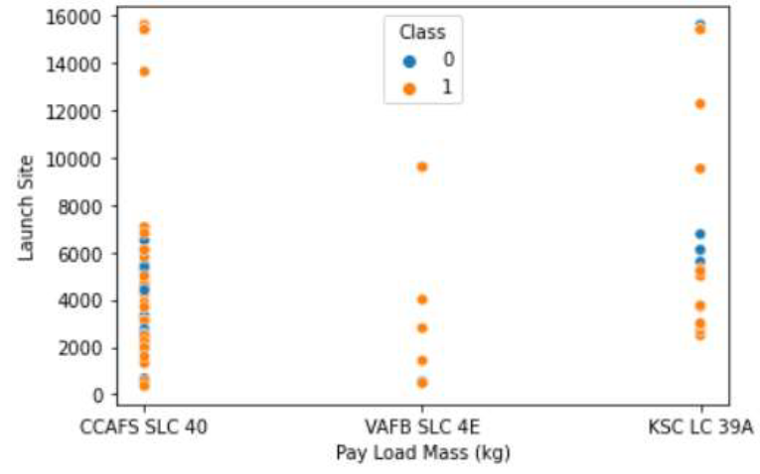
Payload vs. Launch Site
Show a scatter plot of Payload vs. Launch Site
Show the screenshot of the scatter plot with explanations

Slide 20
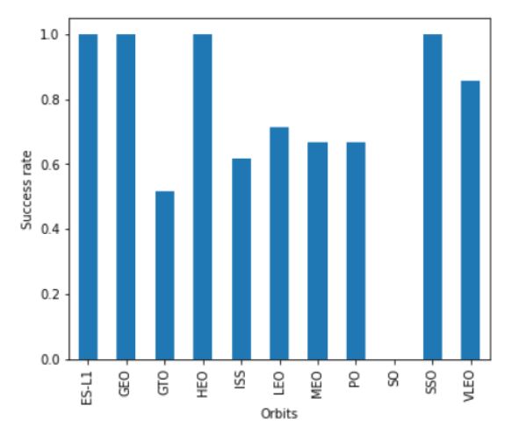
Success Rate vs. Orbit Type
Show a bar chart for the success rate of each orbit type
Show the screenshot of the scatter plot with explanations

Slide 21
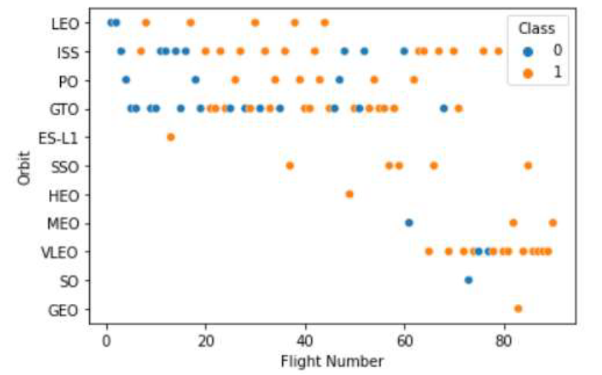
Flight Number vs. Orbit Type
Show a scatter point of Flight number vs. Orbit type
Show the screenshot of the scatter plot with explanations

Slide 22
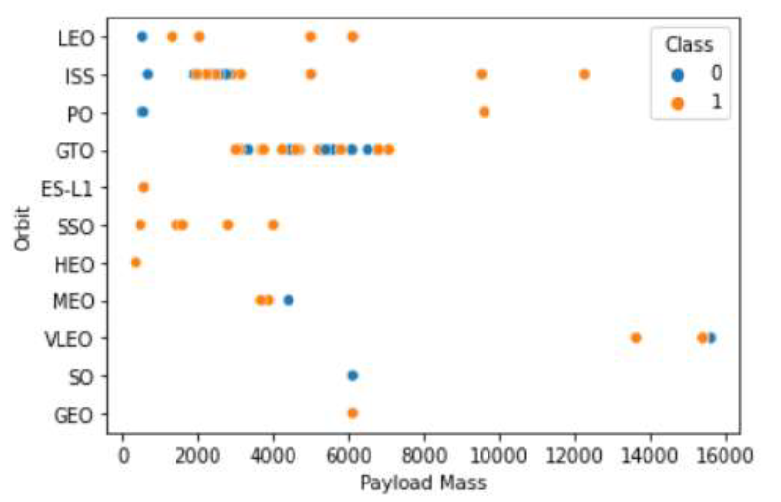
Payload vs. Orbit Type
Show a scatter point of payload vs. orbit type
Show the screenshot of the scatter plot with explanations

Slide 23
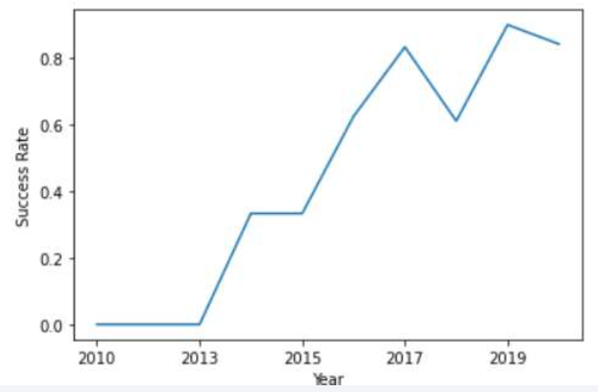
Launch Success Yearly Trend
Show a line chart of yearly average success rate
Show the screenshot of the scatter plot with explanations

Slide 24
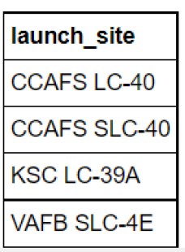
All Launch Site Names
%sqlSELECT DISTINCT launch_siteFROM SPACEXTBL

Slide 25
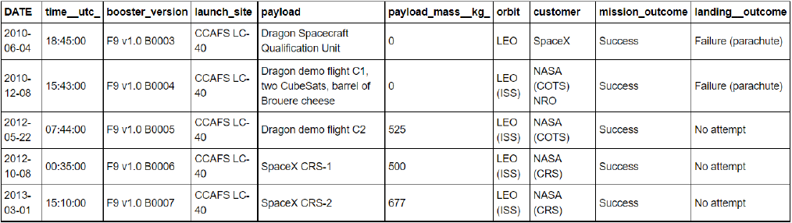
Launch Site Names Begin with 'CCA'
Find 5 records where launch sites begin with `CCA`
Present your query result with a short explanation here
%sql SELECT * FROM SPACEXTBL WHERE launch_site LIKE '%CCA%' LIMIT 5

Slide 26
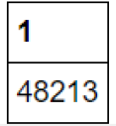
Total Payload Mass
Calculate the total payload carried by boosters from NASA
Present your query result with a short explanation here
%sql SELECT SUM(payload_mass__kg_) FROM SPACEXTBL WHERE customer LIKE '%NASA (CRS)%’;

Slide 27
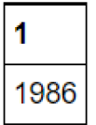
Average Payload Mass by F9 v1.1
Calculate the average payload mass carried by booster version F9 v1.1
Present your query result with a short explanation here
%sql SELECT AVG(payload_mass__kg_) FROM SPACEXTBL WHERE booster_version LIKE '%F9 v1.%’;

Slide 28
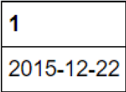
First Successful Ground Landing Date
Find the dates of the first successful landing outcome on ground pad
Present your query result with a short explanation here
%sql SELECT MIN(DATE) FROM SPACEXTBL WHERE landing__outcome LIKE '%Success (ground pad)%’
Select first date (min fnct) when landing outcome was a success

Slide 29
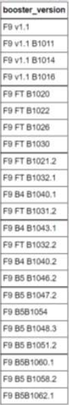
Successful Drone Ship Landing with Payload between 4000 and 6000
List the names of boosters which have successfully landed on drone ship and had payload mass greater than 4000 but less than 6000
%sql SELECT booster_version FROM SPACEXTBL WHERE payload_mass__kg_>4000 AND payload_mass__kg_<6000
Select all booster versions where 4000 kg < payload mass < 6000 kg

Slide 30
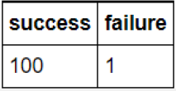
Total Number of Successful and Failure Mission Outcomes
Calculate the total number of successful and failure mission outcomes
Present your query result with a short explanation here
%sql
SELECT s.success, f.failure FROM
(SELECT COUNT(mission_outcome) as success FROM SPACEXTBL WHERE mission_outcome LIKE ‘%Success%’)s,
(SELECT COUNT(mission_outcome) as failure FROM SPACEXTBL WHERE
Mission_outcome LIKE ‘%Failure%’) f

Slide 31
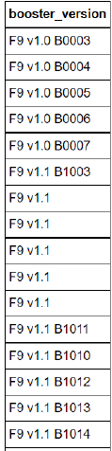
Boosters Carried Maximum Payload
%sql SELECT booster_version FROM SPACEXTBL WHERE (SELECT MAX(payload_mass__kg_) FROM SPACEXTBL)
Select booster_versionwhich has max payload mass (and there were several)

Slide 32
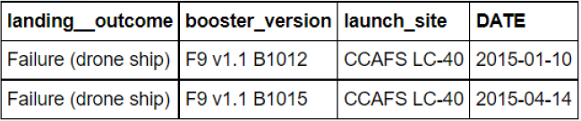
2015 Launch Records
List the failed landing_outcomes in drone ship, their booster versions, and launch site names for in year 2015
%sql
SELECT landing__outcome, booster_version, launch_site, DATE from SPACEXTBL WHERE landing__outcome LIKE '%Failure (drone ship)%' AND DATE LIKE '%2015%'

Slide 33
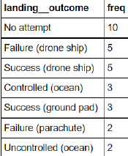
Rank Landing Outcomes Between 2010-06-04 and 2017-03-20
%sql
SELECT landing__outcome, count(landing__outcome) as freq FROM SPACEXTBL WHERE DATE BETWEEN '2010-04-04' AND '2017-03-20’ GROUP by landing__outcomeORDER by freqdesc

Slide 34


Slide 35
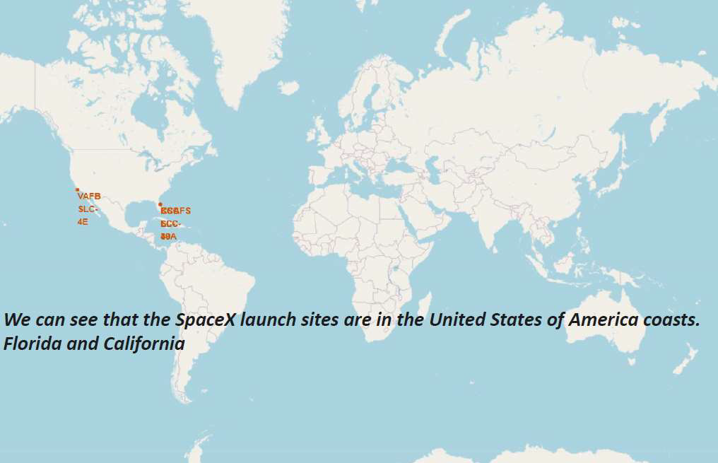
Launch sites

Slide 36
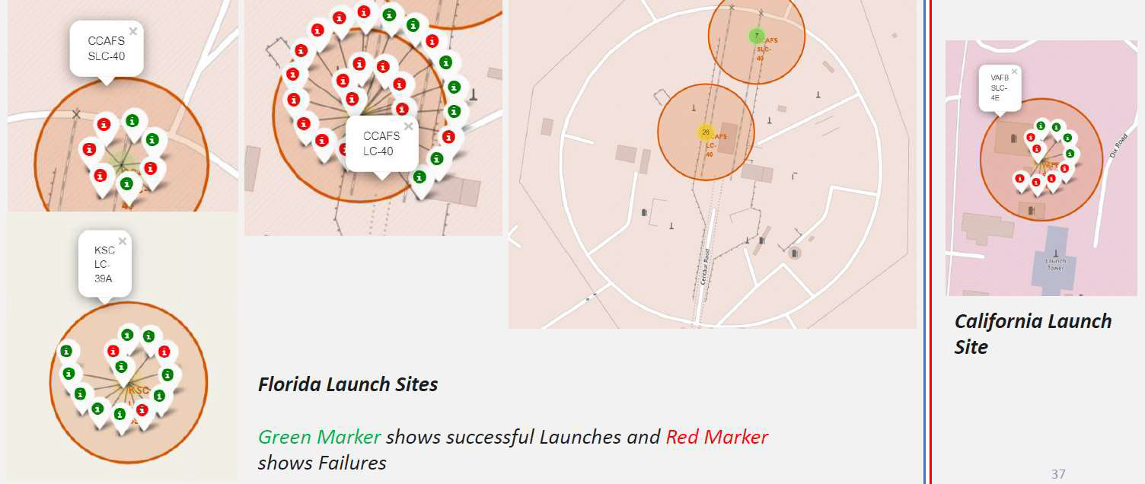
Interactive launch sites

Slide 37
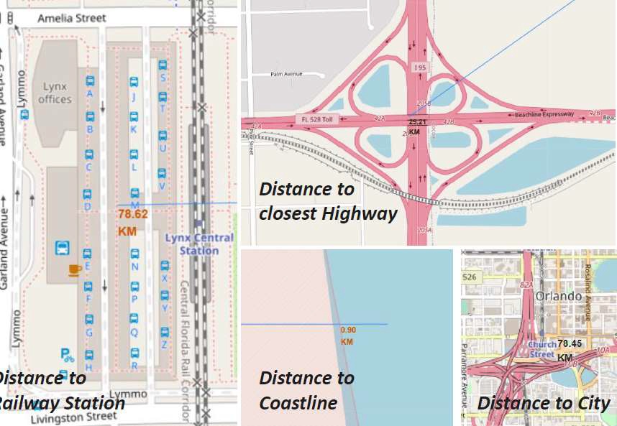
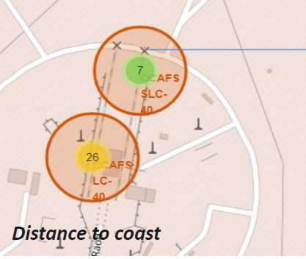
Interactive plot 2
Are launch sites in close proximity to railways? No
Are launch sites in close proximity to highways? No
Are launch sites in close proximity to coastline? Yes
Do launch sites keep certain distance away from cities? Yes

Slide 38


Slide 39
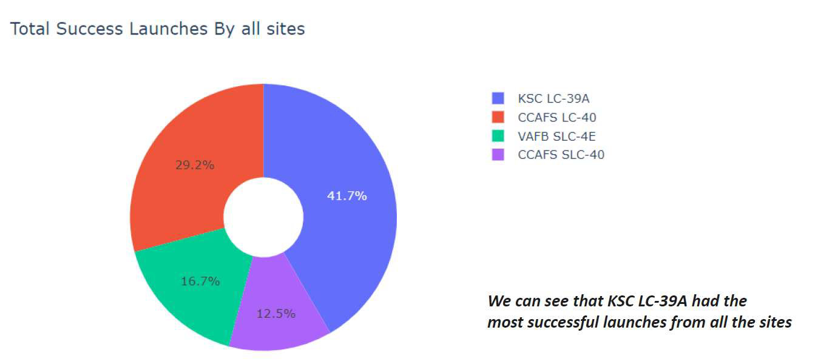
Successful launch sites Pie chart

Slide 40
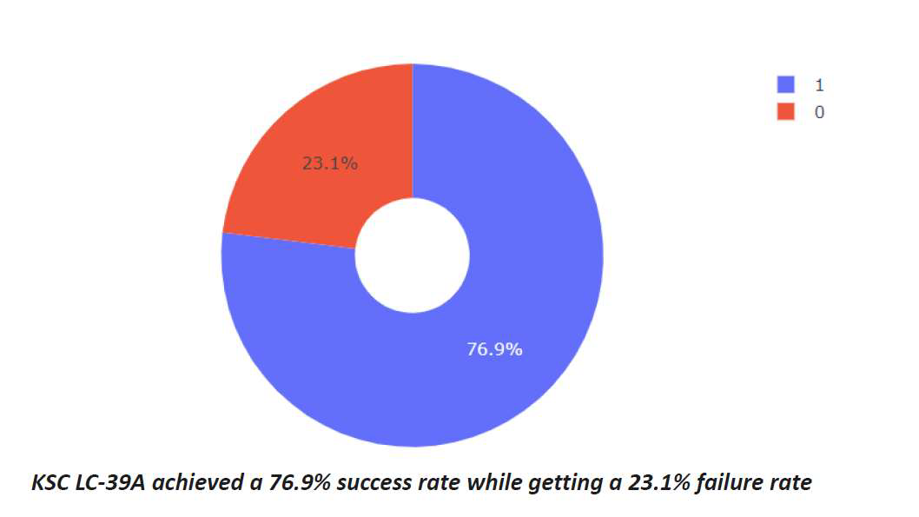
Launch success ratio

Slide 41
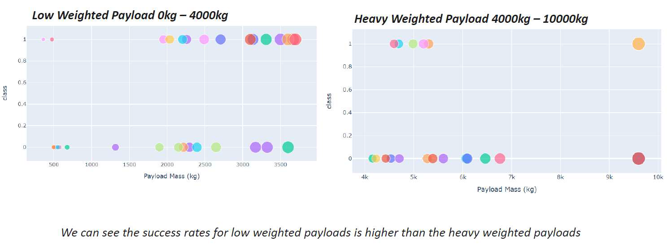
Payload Vs Launch Outcome

Slide 42


Slide 43
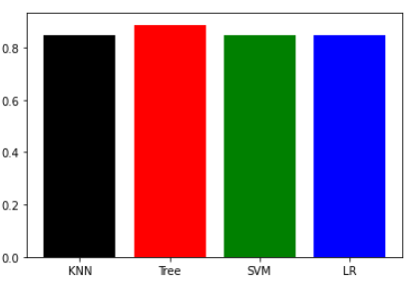
Classification Accuracy
Every bar chart is accurate
For tree_cv accuracy lies at 0.8875

Slide 44
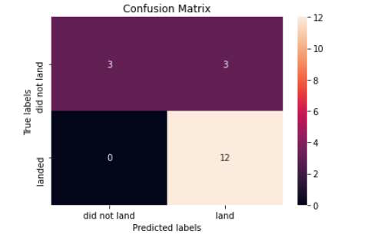
Confusion Matrix
Below confusion matrix of tree_cv is shown
From the matrix we can see the major problem is false positives

Slide 45
Conclusions
Tree classification is best suited for machine learning model
Low weighted payload performs better but on a long term higher payloads are preferred
Longer the companies in the field higher the success rate
GEO,HEO,ES-L1,SSO has the best success rate

Slide 46
Appendix
Include any relevant assets like Python code snippets, SQL queries, charts, Notebook outputs, or data sets that you may have created during this project

Slide 47


